Slide 1
JOMO KENYATTA UNIVERSITY OF AGRUCULTURE AND TECHNOLOGY UNIT CODE:BCT 2315 LEC: DR. Onyango Okeyo GROUP MEMBERS KOSGEI WILSON KIPKOECH SCT212-2101/2015 KIPROTICH DERICK KIPCHUMBA SCT212-3264/2015

Slide 2
A marketing and information sharing platform for farmers based On MVC architecture. (E-farm System)

Slide 3
INTRODUCTION
The purpose of this report is to present the proposed system analysis and design for the marketing sales and information sharing platform for farmers with the intention of ensuring that we two come to an agreement about the proposed solution.

Slide 4
SYSTEM ANALYSIS AND DESIGN
System analysis -planning the development of our systems by specifying the tasks a system should perform and how the various components of the system should be.
. The system design- keeps track of the information that define the architecture and system design to give the us guidance on the architecture of the proposed system.

Slide 5
Executive Summary
Firstly, this report will highlight the system vision by expanding on the project description, system capabilities.
Secondly, in this deliverable the system requirements section is used to describe the functionality listed in the system vision and with the use of diagrams.
Thirdly, the project organization section of this report focuses on the system development approach,
Finally ,the system design which will explain in detail the system analysis.

Slide 6
System development Approach
Throughout the project the analysis, design, development, implementation and testing phases will be conducted using waterfall model that means each phase must be completed fully before the next phase can begin.
We have used this software development model because the project is small and there are no uncertain requirements.
At the end of each phase, a review takes place to determine if the project is on the right path and whether to continue or discard the project.

Slide 7
Cont..
The proposed development for marketing sales and information sharing platform for farmers will be created using Waterfall model approach.
Functionality of the system we have prioritized as follows:
Creation of Authentication
E-commerce module
Forum module
Hire and Lending module
Website Content Management I.e. Static Pages

Slide 8
Project Description and System capabilities

Slide 9
General overview of how the system will work
forum
the part of the application where farmers can ask each other questions on issues affecting them.
They can also provide answers to those question.
A blog post posted by our agricultural expert

Slide 10
Market place
The farmer can sell their produce online
The system cannot allow one to proceed with buying process if he/she is not registered. If the he is registered, he/she can the proceed to payment of the product.
After a successful purchase we offer receipt indicating whether the product has been paid through online payment system or payment is pending until the delivery of the product.
In case default product is delivered we have an order summary of the product where we can access

Slide 11
Hiring and Lending module
Farmers are allowed to hire farm tools and equipment and farm lands. This module provides and easy access to farm tools.
This module seeks to solve the problem that a farmer need to look for a tool from place to place.
Once he gets it he hires for use and upon completion returns it the farm equipment to the owner and once again its available for hiring.

Slide 12
Major system capabilities
it is responsive web-based system
platform independent it could be used on windows and Mac operating systems or even mobile
To manage payment we shall integrate PayPal as our means of payment

Slide 13
Stakeholders of the system
Admin: manage the system they also manage other users and are responsible for entering system data
Expert: these are other who can use the admin site to write educational post
Users: the users of the system

Slide 14
Activities of the stakeholders
Admin
Add, update, delete product to site
Add new and delete user as an admin
Experts
write the educational post in the forum about agriculture
Users
They buy goods and hire farm machinery
Manage their shopping cart
They ask and answer each other question

Slide 15
Functional requirements
Authentication: this is the process of verifying if the user of the system is a genuine registered user. In our e-farm system we have implemented
Login, Password changed ,Password reset, Logout
Registration: this is the process of submitting your credentials that could be used by the system for the purpose of authentication or just identifying yourself with the system
Search: if one wants to find a product we there a search functionality that enables on to quickly search for what he wants

Slide 16
Cont..
Shopping cart: shopping cart is used to add a list of products one to buy to a session called cart this if one clicks the buy button in the system
Checkout: this is where the user uses to proceed to the placing order and finally proceed to payment
Ordering : this is another functional requirement of the system that enables one to provide details that he/ she want to be used in case of delivery of a product

Slide 17
Cont..
Generating billing pdf: these document indicates whether the user has paid for the product or payment is still pending.
Commenting: enable the user to give his or her view on the post
Like: a liking system that will enable users like comments

Slide 18
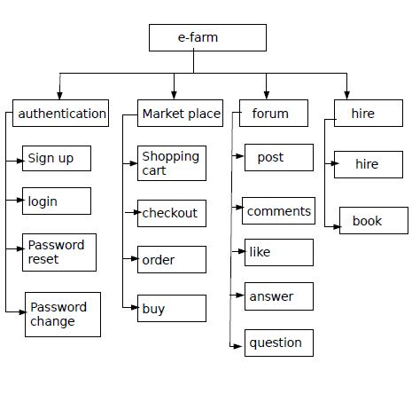
Functional decomposition diagram

Slide 19
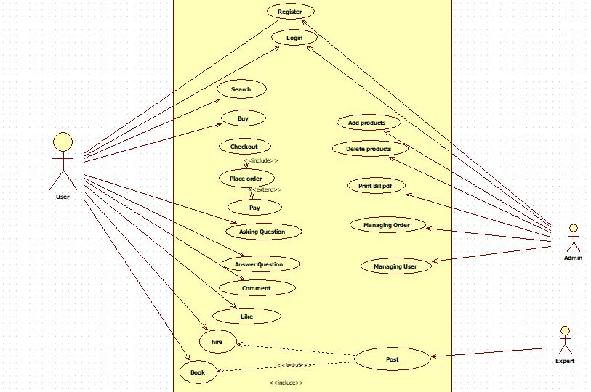
Use case diagram

Slide 20
Non-functional requirements
Security: authentication for one to buy goods is key for disallowing anonymous users from using the systems
Usability: the modified website interface and the internal database system design to be user friendly and straightforward
Scalability: according to our research the system can be used by many users in future so we taken the issue of extensibility into account
Reliability: ensuring that software and hardware will perform the required tasks

Slide 21
System requirements
Hardware requirements
Webserver
Apache
2GB or higher recommended per CPU core

Slide 22
Cont..
Software requirements
Web browsers
Microsoft Internet Explorer
Firefox
Google Chrome
Safari
Operating systems
Microsoft Windows
Mac OS
Linux

Slide 23
SYSTEM DESIGN
This part will discuss the design phase of the system components, architecture, interfaces and data that will satisfy whatever was mention in the analysis phase.
The system analysis is transformed by graphical notation showing the user how the system will flow.

Slide 24
Cont..
The following are the types of design we shall discuss for our system
Architectural Design
Physical Design
User Interface Design
Process design
Data Design
Database Design
Entity Relational Diagram

Slide 25
Architectural Design-
It focusses on the architecture of the system and describes the structure, behaviour and an overview of analysis.
It defines the relationship between various modules of the system development.

Slide 26
MVC architecture
Controller that renders data from our database using URL dispatchers
Models where our database are going to be based
View this the templates it is the html content that is displayed as the web application

Slide 27
URL
request
controller
server
Response
model
views

Slide 28
Client- Server Architecture
Client-server architecture (client/server) is an architecture in which each computer or process on the network is either a client or a server.
Client
Software e.g. O.S, Browser.
Communication Medium.
(Protocol H/W and S/W)
Server Software
e.g. XAMPP

Slide 29
Physical Design
The actual process is specified. The process could be the inputs the user has put into the system it could also include the outputs the system will provide after some user execution.
The user interface design, process design, and data design.
It produces the working system by defining the design specification that specifies exactly what the candidate system does

Slide 30
User interface design
This design illustrates how the viewers of the system will interact as they navigate over the pages.
The interface will determine user’s perception of the system.
The following are the design principles we shall be using in our system. The simplicity principle, structure principle, visibility principle, feedback principle, tolerance principle.

Slide 31
Cont..
Input Controls: buttons, text fields, checkboxes, radio buttons, dropdown lists, list boxes, toggles, date field
Navigational Components: , slider, search field, pagination, slider, tags, icons
Informational Components: tooltips, icons, progress bar, notifications, message boxes, modal windows.

Slide 32
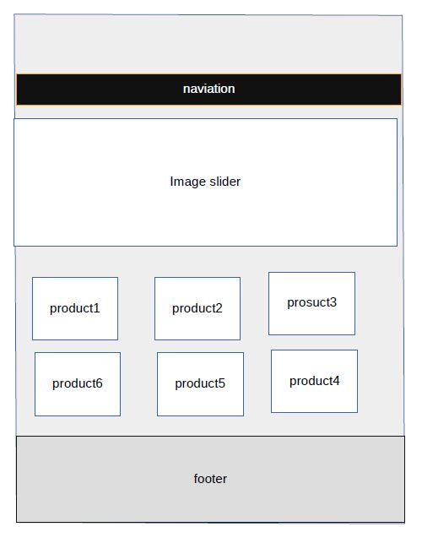
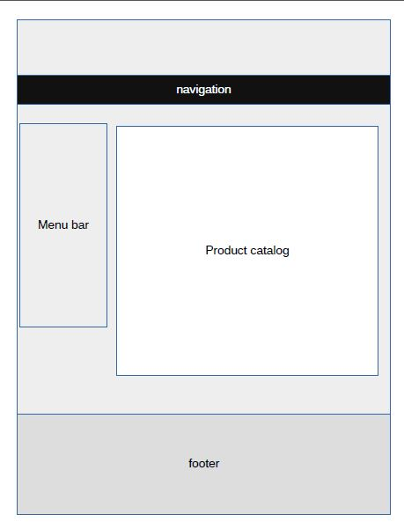
Cont..

Slide 33
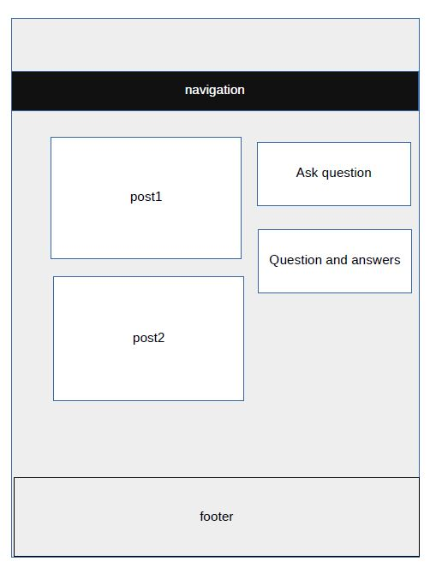
Cont..

Slide 34
Process Design
Process design is concerned with how data moves through the system and with how and where it is validated, secured and transformed as it moves into, through and out of the system.
Some of the process that we shall have in our system are payment process, checkout process, Hiring and lending process

Slide 35
Database Design
Database play a crucial role in the development of any application
This is where the system content will be stored.
Our E-farm system will have several databases as we shall illustrate using the Entity relation diagram below.

Slide 36
Entity-Relational Diagram
An ER diagram is a graphical representation of an information system that shows.
The relationship between people, objects, concepts or events within that system. It is composed of three mains: components entities, which are objects or concepts that can have data stored about them and The relationship between those entities and the cardinality, which defines that relationship in terms of numbers.

Slide 37
Cont..
Our ER will show how our databases are you to be related.
The following are the tables and how they are related.

Slide 38
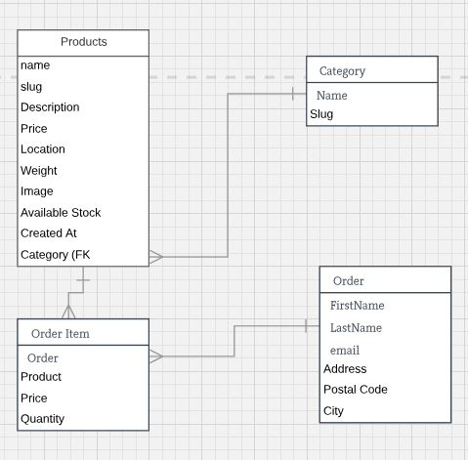
ER product Tables

Slide 39
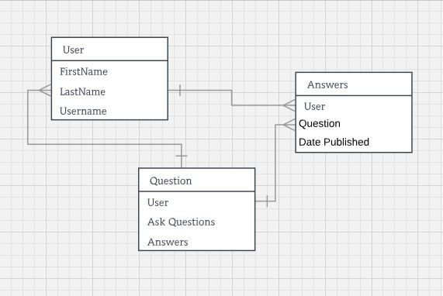
ER User Database

Slide 40
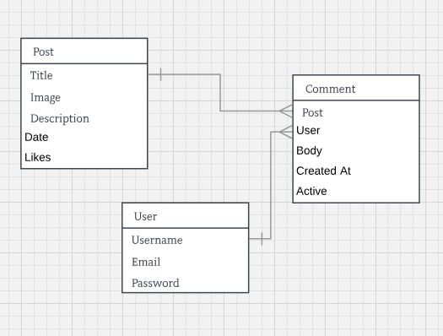
ER post Table

Slide 41
Conclusion
The above analysis and design report gives a well model oh how the system is going to be developed.
The analysis part explains the requirement part as an essential part to come up with the functional requirement.
The design part gives a feel of the project that we are to come up with.

